Slide 1
AMAZON FINE FOOD REVIEW ANALYSIS
BY TAPAS KUMAR PANIGRAHI

Slide 2
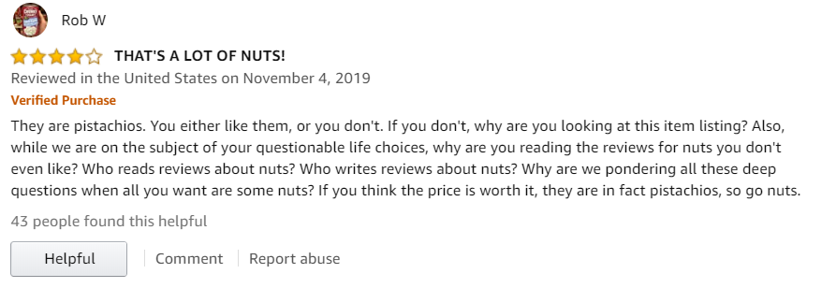
Amazon reviews page
Amazon.com

Slide 3
Let’s understand the Data
Data includes :
Reviews from October 1999 –October 2012
568,454 reviews
256,059 users
74,258 products
260 users with >50 reviews

Slide 4
Attributes of the data:
PRODUCT ID – Unique identifier for the product
USER ID – Unique identifier for the user
PROFILE NAME – Profile name of the user
HELPFULNESS NUMERATOR – Number of users who found the review helpful
HELPFULNESSDENOMINATOR – Number of users who indicated ID - Row id whether they found the review helpful or not
SCORE – Rating between 1 and 5
TIME – Timestamp for the review
SUMMARY – Summary of the review
TEXT – Text of the review

Slide 5
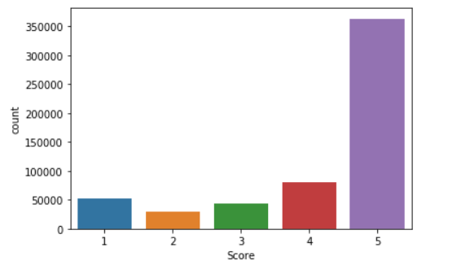
EDA

Slide 6
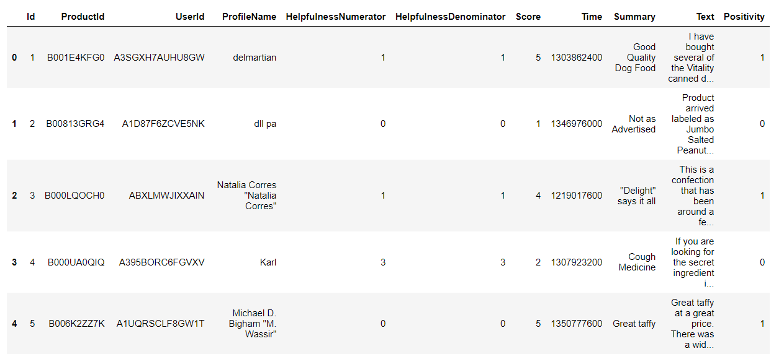

Slide 7
Objective :
REVIEW
Given a review ,determine whether a review is positive or negative ?
POSITIVE
NEGATIVE
SCORE 4 OR 5
SCORE 1 OR 2

Slide 8
Constructing the model
“Text” is the most important features among all of the feature.
So I classify the review to be positive or negative based on Text(review)
Here I used logistic regression.

Slide 9
Text to vector (used methods)
Bag of words
Bigram
tfidf

Slide 10
BAG OF WORDS
LIMITATTION:
Review1: The food is very tasty.
Review2:the food is not tasty.
vector 1: the food is very not tasty
1 | 1 | 1 | 1 | 0 | 1
Vector2: the food is very not tasty
1 | 1 | 1 | 0 | 1 | 1
The distance between these two vectors are approximately same ,so they belongs to same class . But they are of opposite meaning.

Slide 11
BIGRAM
Bigram addresses the issue of bag of word.
It takes pair of consecutive words as one dimension.
LIMITATION:
No of bigram > No of unigram
So dimension increases .it leads to some problem

Slide 12
RESULTS:
 | MODEL NAME | ACCURACY
MODEL 1 | BAG OF WORDS | 0.819587797615879
MODEL 2 | BAG OF WORDS(BIGRAM) | 0.8991346890822678
MODEL 3 | TFIDF | 0.8338351323376996

Slide 13
The end

